Slide 1
JCR
for developers

Slide 2
TABLE OF CONTENT
JCR Concept
JCR Queries
JCR Specification
JCR Configuration
JCR Key Features
Code Examples
Export & Import
Exercises

Slide 3
JCR Concept

Slide 4
INTRODUCTION
Java Content Repository (Specification JSR 170)
http://jcp.org/aboutJava/communityprocess/final/jsr170/index.html‏
Content repository
Hierarchical structure
Used like a file system in eXo
Advances services (queries, locks, versioning,...)‏

Slide 5
INTRODUCTION
One or several repositories
One eXo instance only configures one repository
Multiple repositories are only used for multi-tenants (eXo Cloud)
Each repository has several workspace
There are about 10 workspace in eXo Platform 3.5
One workspace for a set of features (example Knowledge features)
Each workspace has one root node
Each node can have child nodes
Each nodes can have properties
Properties can be of different types (text, binary, number, …)

Slide 6
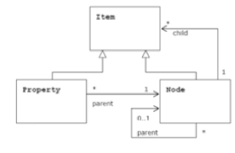


INTRODUCTION
Repository
Repository
Workspace
Workspace

Slide 7
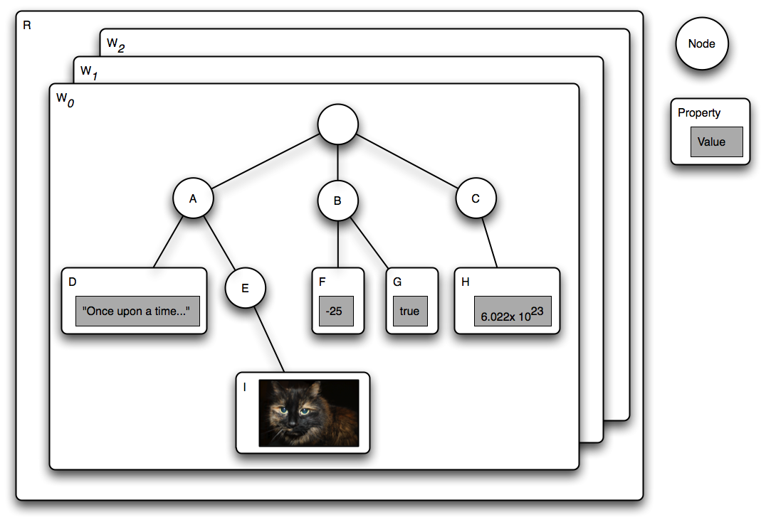
INTRODUCTION

Slide 8
INTRODUCTION
eXo uses JCR to manage all persistent data storage :
Portal Configuration (pages, navigations, preferences...)‏
DMS and WCM (eXo ECM)‏
Knowledge, Collaboration, Social
Available for your application development, but you are not forced to use it.

Slide 9
INTRODUCTION
Common java API for all content workspaces
Agnostic to datasource, protocol and architecture
Standardize complex features
Useful for content oriented applications

Slide 10
JCR Specification
Levels, Options, eXo Features

Slide 11

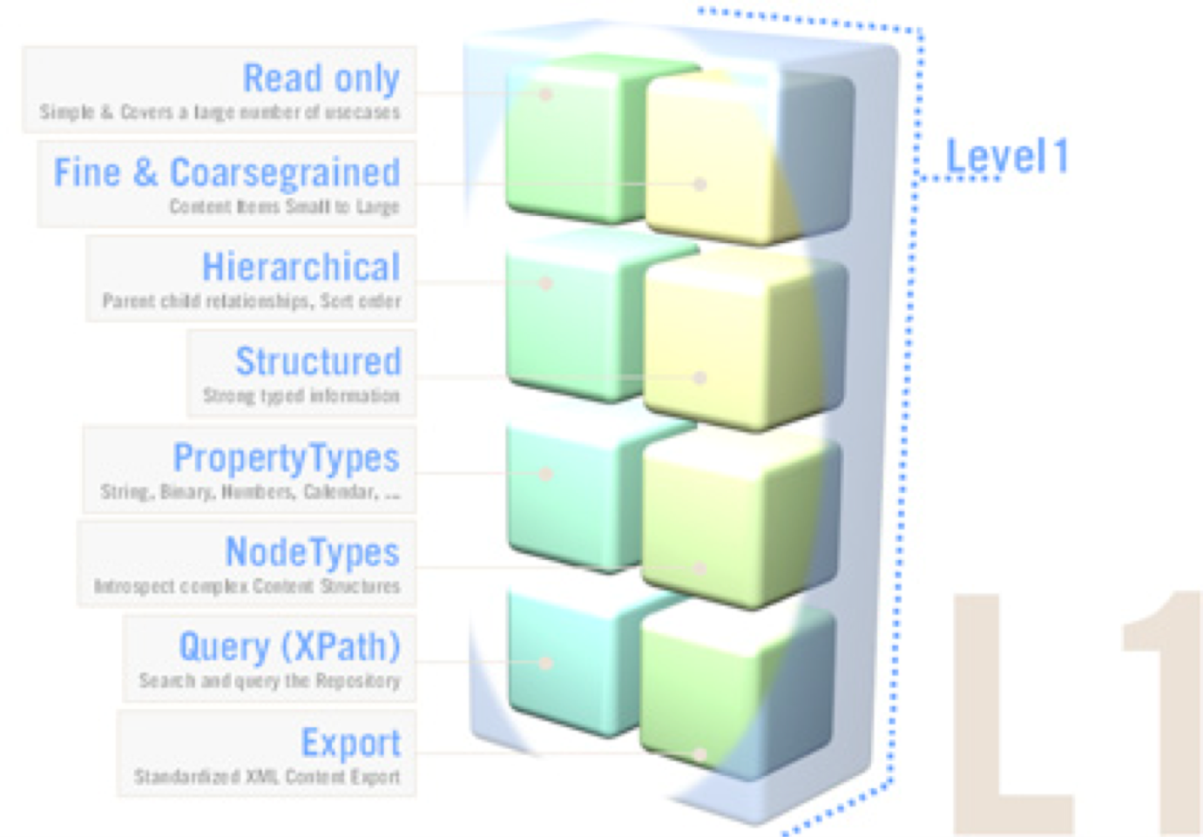
JCR Spec Level 1
Level 1 includes :
access methods to the current repository
read method to access items
XML export
XPath query possibility
nodeType management
Namespace management

Slide 12

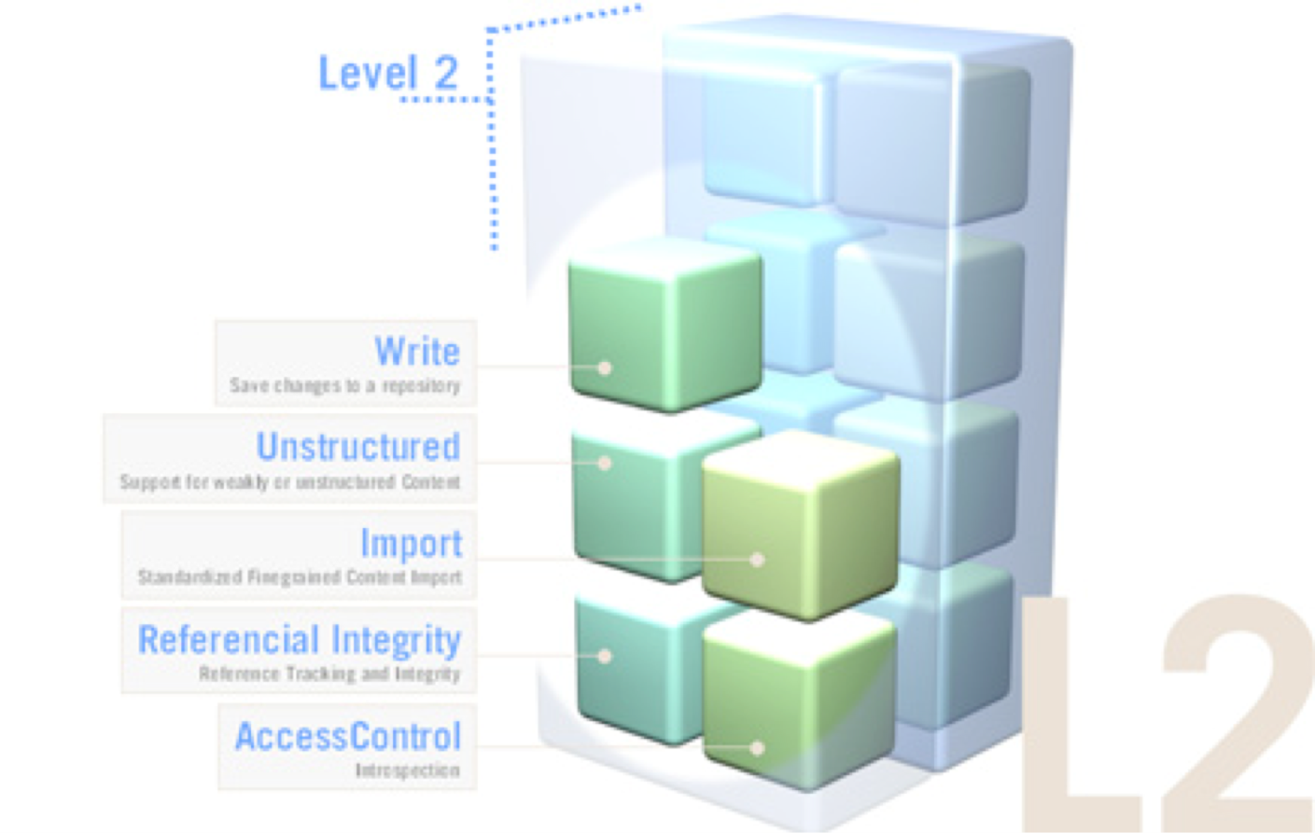
JCR Spec Level 2
Level 2 includes:
write methods to repository
XML import format
Possibility to modify a node path (copy, move, clone, update)
Referential integrity

Slide 13
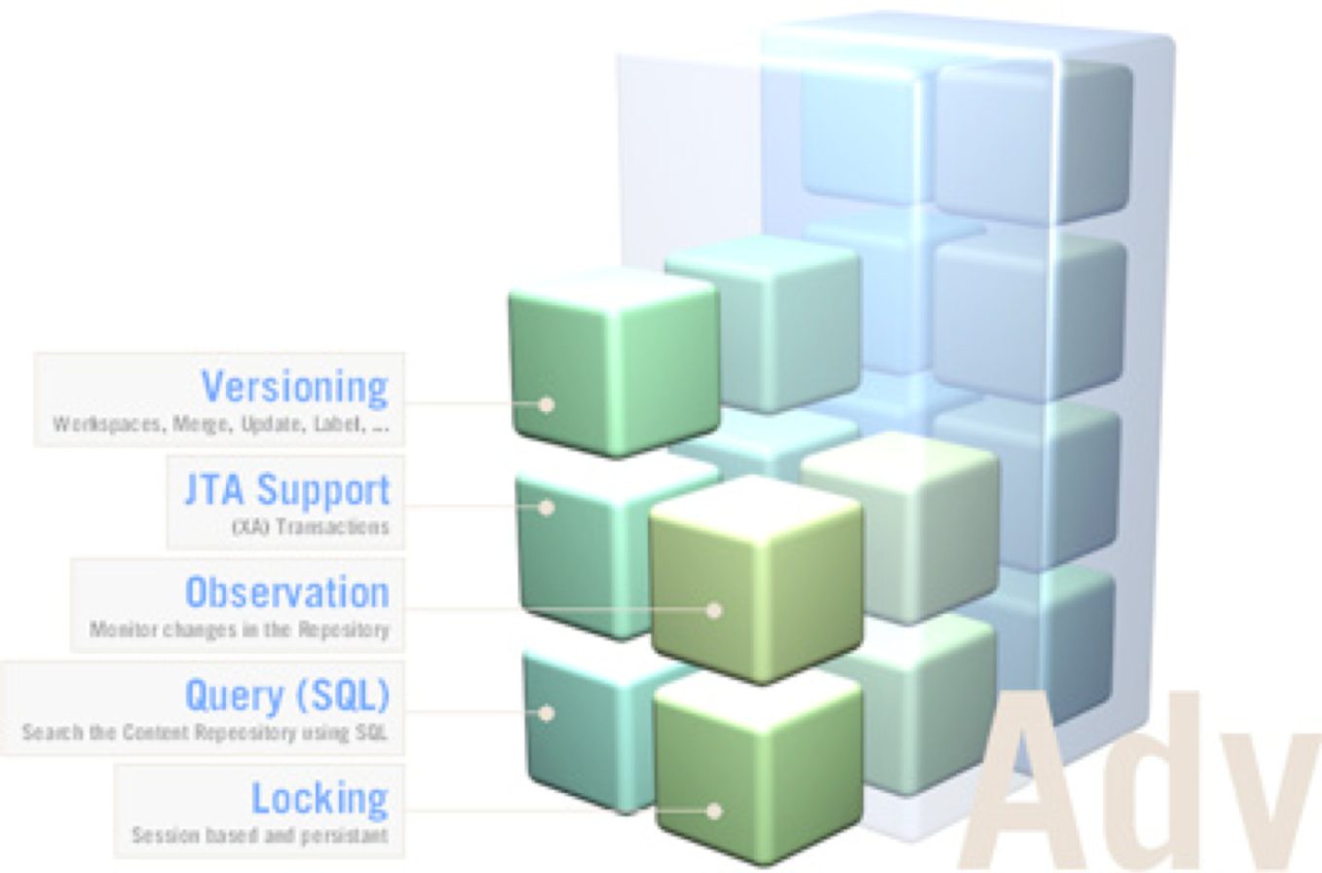

Optional Features
Optional features include :
versioning
locking
observation
possibility to make JCR-SQL queries
transactions

Slide 14
JCR eXo FEATURES
Security
Security is natively linked to the organizational service: each node can be associated to a membership or a group, or a full set of permissions
Read, Write, Modify, Delete
Different ways to access the API
WebDAV, JCR RMI, REST API, CMIS
XML Configuration XML for JCR by plugins
Repository
Workspace
NameSpace
NodeType

Slide 15
Key Features

Slide 16
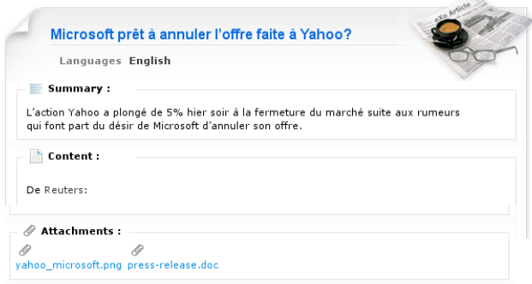
Example
Example: exo:article
3 properties
title
summary
content
many sub-nodes files

Slide 17
Name Spaces
Namespaces like XML
A prefix is a shortcut, which is a URI.
URIs are used to avoid collisions.
A prefix, delimited by a single ':' (colon) character that indicates the namespace of the item. Example: “exo:article”
The specification contains the following reserved names:
jcr: Used for JCR internal types. Do not use it.
nt: Used by primary types. Do not use it.
mix: Used for the names of built-in mixin node types. Do not use it.
xml: Used for XML compliance. Do not use it.
“”: Indicates the default namespace

Slide 18
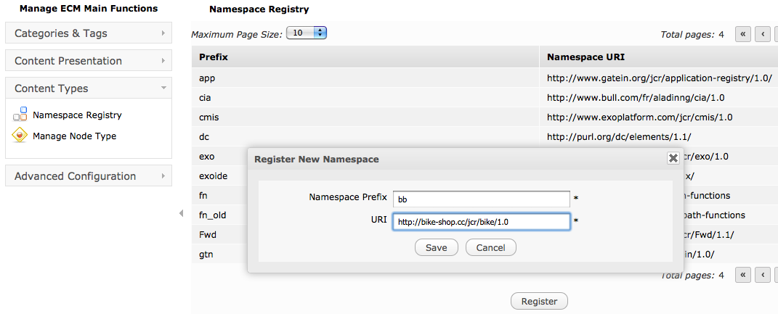
Name Spaces
Name Spaces and Node Types in Content Administration

Slide 19
Primary Node Type
Every node must have one and only one «primary node type».
The primary node defines possible properties and possible child nodes of this node, besides of other requirements and restrictions.
The definition includes the names and types of properties and child nodes.
Each node contains a specific property called jcr:primaryType which contains the name of the primary type of the node.
Inheritance
A primary node always inherits from a supertype.
Inheritance include the property and child node definitions.
A primary node type inherits also the mixin types that are assigned to the supertype.
The root node type is nt:base. “nt:base” is the base type for all other types.

Slide 20
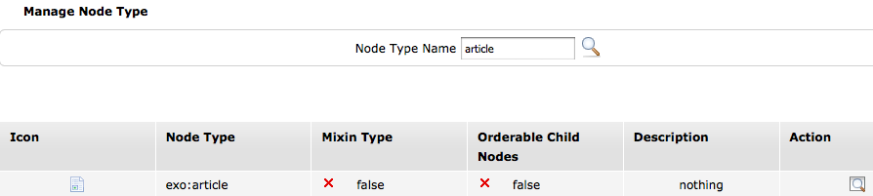
Node Type
Node Type Search

Slide 21
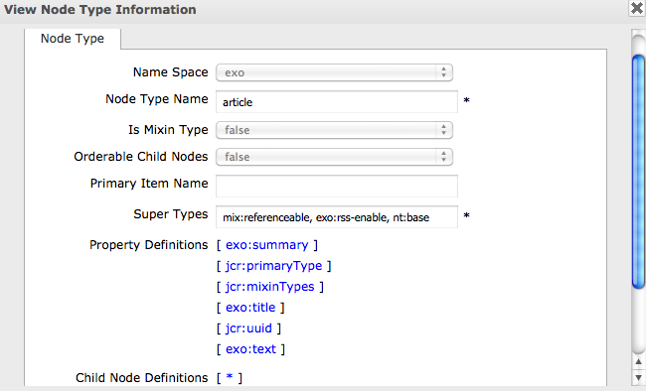
Node Type

Slide 22
NODE TYPE DEFINITION BY XML
<nodeType name="exo:article" isMixin="false”>
<supertypes>
<supertype>nt:base</supertype>
<supertype>mix:referenceable</supertype>
<supertype>exo:rss-enable</supertype>
</supertypes>
<propertyDefinitions>
<propertyDefinition name="exo:text" requiredType="String"
autoCreated="false" mandatory="false" onParentVersion="COPY"
protected="false" multiple="false">
<valueConstraints />
</propertyDefinition>
</propertyDefinitions>
<childNodeDefinitions>
<childNodeDefinition name="*" defaultPrimaryType="nt:file"
autoCreated="false" mandatory="false" onParentVersion="COPY"
protected="false" sameNameSiblings="true">
<requiredPrimaryTypes>
<requiredPrimaryType>nt:file</requiredPrimaryType>
</requiredPrimaryTypes>
</childNodeDefinition>
</childNodeDefinitions>
</nodeType>

Slide 23
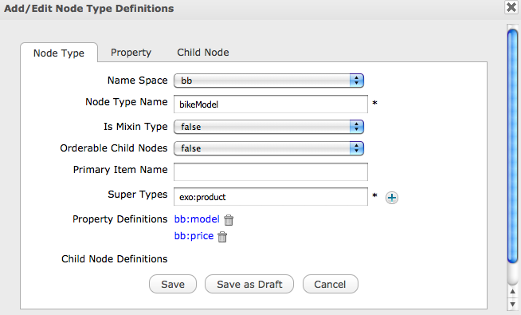
Node Type Creation

Slide 24
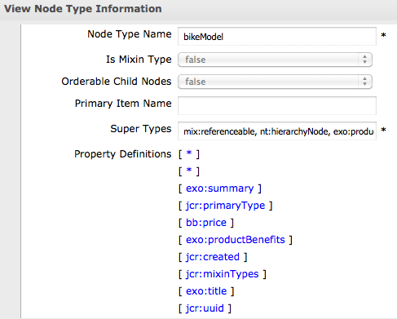
Node Type Inheritance

Slide 25
Mixin Node Type
A node can possess one or many mixin types.
A mixin type adds properties and child node possibilities and requirements to a node.
It cannot serve, by itself, to define the structure of a node. The structure is always defined by a primary type.
There is no required supertype for mixin types
A particular supported node type is either a primary type or a mixin type; it cannot be both.
Mixin property
When you add a mixin nodetype to a node, the node acquires a new property called jcr:mixinTypes. This multi-value property contains the names of the mixin types.

Slide 26
Predefined Mixins
mix:referenceable:
This node type specifies an auto-created, mandatory, STRING property called jcr:uuid. This property is set automatically by the implementation when the mix:referenceable node is created or when this mixin type is added to an existing node.
A node must be mix:referenceable in order to be the target of a REFERENCE property.
mix:versionable:
This mixin node type supports the versioning system. For a node to be versionable, it must be of this mixin node type.

Slide 27
Locking
mix:lockable
Only nodes with mixin node type mix:lockable (inherited as part of their primary node type or explicitly assigned) may hold locks.
This feature allows a user to temporarily lock nodes in order to prevent other users from changing them.
Lock Deepness
A lock can be specified as either shallow or deep. A shallow lock applies only to its holding node. A deep lock applies to its holding node and all its descendants.
Lock Owner
The user who places a lock on a node is called the lock owner.

Slide 28
Property Types
PropertyType.DATE
ISO 8601:2000-compliant format: sYYYY-MM-DDThh:mm:ss.sssTZD
PropertyType.NAME
A NAME is a pairing of a namespace and a local name.
PropertyType.PATH
A PATH property is an ordered list of path elements. A path element is a NAME plus an with optional index. A path may be absolute or relative. Example: /myapp:document/myapp:paragraph[3]
PropertyType.REFERENCE
A REFERENCE property stores the UUID of a referenceable node (one having type mix:referenceable). The referential integrity of REFERENCE properties must be guaranteed.

Slide 29
Exercise Bike Model
Preparation: Create the node type “BikeModel”
Create a namespace “bb”
Create a node type “bikeModel” that inherits from “exo:product”. Do not save yet! Add the string property “model“ and the double property “price” to the bikeModel node type. Now, save the node type. After saving you cannot modify the node type anymore!
This node type will be used later.

Slide 30
JCR Export and Import
System View – Document View

Slide 31
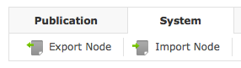
Export - Import
You can export a node using the Content Explorer.
This exports the node and all its descendants to an xml file.
You import the exported file to another node or another installation of eXo, also for transferring between from Pre-Prod and Production systems.

Slide 32
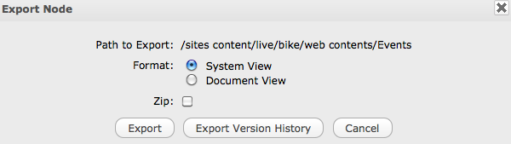
Export - Import
When exporting you can choose between two different xml formats.

Slide 33
System and Document View
2 XSD schemas for export and import
System View
The system view mapping provides a complete serialization of workspace content to XML without loss of information.
Document View
The specification states: “The document view is designed to be more human-readable than the system view, though it achieves this at the expense of completeness.” Notably, the node type information is not included.
Root node
The workspace root node is mapped to an XML element with the name jcr:root, because XML elements cannot have empty-string names

Slide 34
JCR EXPORT USING THE DOCUMENT VIEW
<myapp:document jcr:primaryType="mynt:document" myapp:title="JSR 170" myapp:lead="Content Repository"> <myapp:body jcr:primaryType="mynt:body"> <myapp:paragraph jcr:primaryType="mynt:paragraph" myapp:title="Node Types" myapp:text="An important feature..."/> </myapp:body> </myapp:document>

Slide 35
System View
<sv:node xmlns:jcr="http://www.jcp.org/jcr/1.0"xmlns:nt="http://www.jcp.org/jcr/nt/1.0"xmlns:mix="http://www.jcp.org/jcr/mix/1.0" xmlns:sv="http://www.jcp.org/jcr/sv/1.0"xmlns:myapp="http://mycorp.com/myapp"xmlns:mynt="http://mycorp.com/mynt" sv:name="myapp:document"> <sv:property sv:name="jcr:primaryType" sv:type="Name"> <sv:value>mynt:document</sv:value> </sv:property> <sv:property sv:name="myapp:title" sv:type="String"> <sv:value>JSR 170</sv:value> </sv:property> <sv:property sv:name="myapp:lead" sv:type="String"> <sv:value>Content Repository</sv:value> </sv:property> <sv:node sv:name="myapp:body"> <sv:property sv:name="jcr:primaryType" sv:type="Name"> <sv:value>mynt:body</sv:value> </sv:property> <sv:node sv:name="myapp:paragraph"> <sv:property sv:name="jcr:primaryType" sv:type="Name"> <sv:value>mynt:paragraph</sv:value> </sv:property> <sv:property sv:name="myapp:title" sv:type="String"> <sv:value>Node Types</sv:value> </sv:property> <sv:property sv:name="myapp:text" sv:type="String"> <sv:value>An important feature...</sv:value> </sv:property> </sv:node> </sv:node></sv:node>

Slide 36
Encoding
The output XML is encoded in UTF-8
Escaping
Escaping of names: The escape character is the underscore (“_”). Any invalid character is escaped as _xHHHH_, where HHHH is the four-digit hexadecimal UTF-16 code for the character.
“My Documents” is converted to “My_x0020_Documents”,
“My_Documents” is not encoded
Escaping of XML characters
Ampersand (&), less-than symbol (<), greater-than symbol (>), apostrophe ('), and quotation mark (") are escaped as &amp;, &lt;, &gt;, &apos; and &quot;.
A BINARY property is recorded using Base64 encoding.

Slide 37
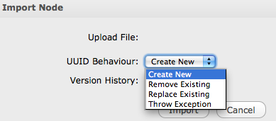
Export - Import
When importing you may have conflicts of UUID which by definition have to be unique. PLF-2970

Slide 38
Exercise: Export - Import
Export and Import
Open the Sites Explorer and test the export and import.
Open the folder: /bike/web contents/Events
Export this node.
Scrutinize the exported file. Compare the System View and Document View.
Delete this node and test it.
Import the node to the same parent node and test again.
Extra: Import to a different location.
Extra: Test UUID conflicts. Try out the options.
Extra: Export a node and import it on a different system.

Slide 39
JCR Queries
Like SQL

Slide 40
JCR Queries
XPath queries are deprecated.
SQL have a better performance.
The fastest access is using the access methods getNode().getChild().

Slide 41
JCR SQL Queries
Database View
SQL queries can be thought of as working against a database view of the workspace being searched.
Each node type (primary or mixin) corresponds to a table.
Each column in the table corresponds to a property defined in or inherited by that node type.
Each row corresponds to a node in the workspace.
Note that because of the hierarchical structure of node type definitions, nodes will appear in more than just one table.
Example: Querying the nt:base table will show all nodes in the workspace, but that table will be limited to the columns corresponding to the properties defined by nt:base: jcr:primaryType and jcr:mixinTypes.

Slide 42
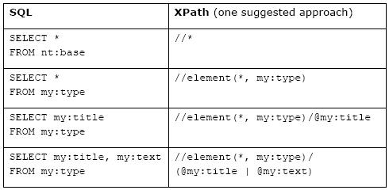
JCR SQL QUERY

Slide 43
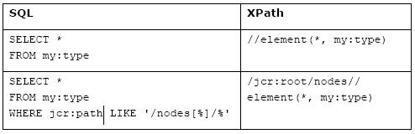
JCR SQL QUERY – Path filter

Slide 44
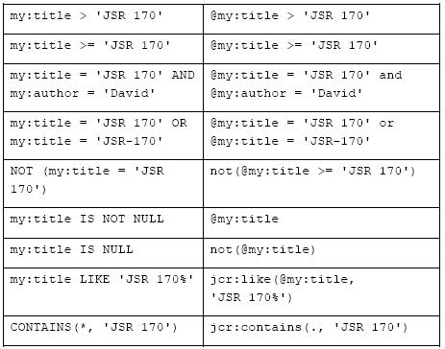
JCR SQL QUERY – COMPARISONS

Slide 45
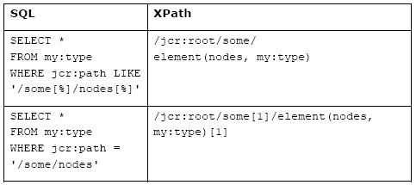
JCR SQL Query – Same name siblings

Slide 46
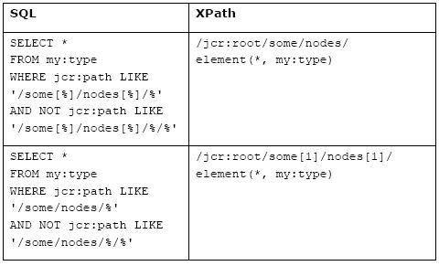
JCR SQL Query – Same name siblings

Slide 47
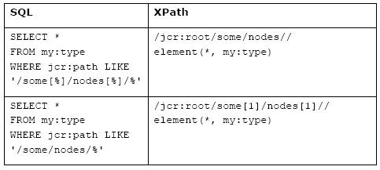
JCR SQL Query

Slide 48
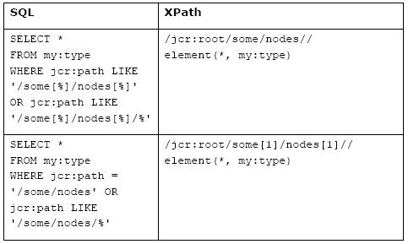
JCR SQL Query – any descendant node

Slide 49
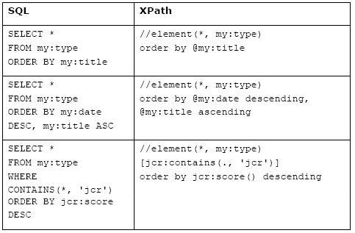
JCR SQL Query – ORDER BY

Slide 50
Like and Contains
Like
where exo:title LIKE '%Java%’
Contains
where contains(*, 'JSR 170’)
where contains(@myapp:title, 'JSR 170’

Slide 51
JCR Configuration
XML Files

Slide 52
Configuration Files
Start file
webapps/platform-extension/WEB-INF/conf/jcr/jcr-configuration.xml
RepositoryServiceConfiguration
The RepositoryServiceConfiguration points to “war:/conf/jcr/repository-configuration.xml”.
This file can be found in: webapps/portal/WEB-INF/conf/jcr/repository-configuration.xml
These files might be overwritten in another webapp. See module eXo extensions.
You must not manipulate these files.

Slide 53
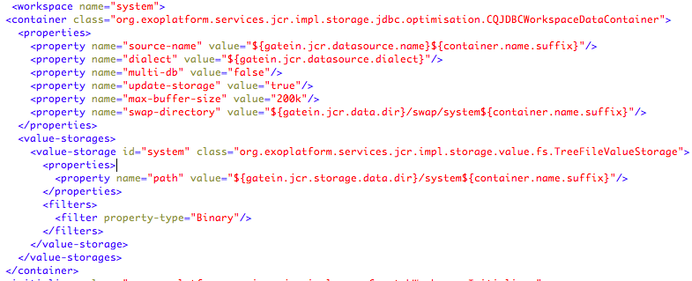
Repository Configuration
Example: “war:/conf/jcr/repository-configuration.xml”

Slide 54
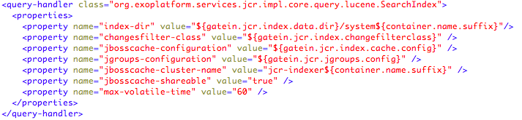
Lucene Configuration
Example: “war:/conf/jcr/repository-configuration.xml”, Lucene index defined for each workspace.

Slide 55
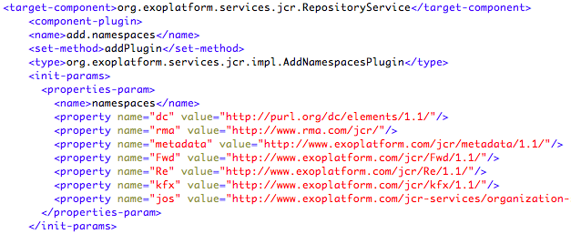
JCR Namespace Configuration
Example: /webapps/ecm-wcm-extension/WEB-INF/conf/dms-extension/dms/jcr-component-plugins-configuration.xml

Slide 56
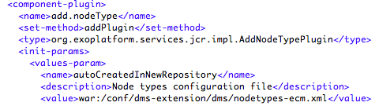
Node Type Configuration
Example: /webapps/ecm-wcm-extension/WEB-INF/conf/dms-extension/dms/jcr-component-plugins-configuration.xml

Slide 57
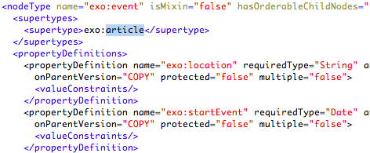
Node Type Configuration
Example: /webapps/ecm-wcm-extension/WEB-INF/conf/dms-extension/dms/nodetypes-ecm.xml

Slide 58
JCR Code Examples
JCR SEssions

Slide 59
JCR Coding
In order to access to the JCR you need to use the RepositoryService
Get the current container
ExoContainer myContainer = ExoContainerContext.getCurrentContainer();
Get the instance of the RepositoryService
RepositoryService repositoryService = (RepositoryService) myContainer. getComponentInstanceOfType(RepositoryService.class);
Always use the current repository – never call it by its name:
Repository repository = repositoryService.getCurrentRepository();

Slide 60
JCR Session
For opening a session you have to login to a workspace.
Credentials credentials = new SimpleCredentials("root", "gtn".toCharArray()); // get a session on workspace ”collaboration” Session jcrSession = repository.login(credentials, "collaboration");
Thread session
// Automatic authentication of the current user in the thread, no need to know the user password: Session jcrSession = repository.login("collaboration");
System Session
This session has unlimited permissions, use it with care. Never use a system session on user operations!
Session jcrSession = repository.getSystemSession(“collaboration”)

Slide 61
Summary
import javax.jcr.*
import javax.jcr.query.*
import org.exoplatform.services.jcr.RepositoryService
import org.exoplatform.container.ExoContainerContext;
ExoContainer myContainer = ExoContainerContext.getCurrentContainer();
RepositoryService repositoryService = (RepositoryService) myContainer. getComponentInstanceOfType(RepositoryService.class);
Repository repository = repositoryService.getCurrentRepository();
Session jcrSession = repository.login("collaboration");

Slide 62
Node Operations
Get the root node of the workspace
Node root = jcrSession.getRootNode();
Search all child nodes of the root node
NodeIterator iterator = root.getNodes(); while (iterator.hasNext()) { Node iterNode= iterator.nextNode(); System.out.println( iterNode.getName() + “ “ + node.getProperty(”jcr:uuid").getValue().getString() ); }
Direct Access
root.getNode(“/sites content/live/acme/documents”);

Slide 63
Node Operations
Queries
QueryManager qm = jcrSession.getWorkspace().getQueryManager();
Query q = qm.createQuery("select * from exo:article", Query.SQL)
NodeIterator ni = q.execute().getNodes();
Node.getIndex()
The method getIndex() returns the index of this node within the ordered set of its same-name sibling nodes.
MultiValue Properties:
Value[] values = node.getProperty(“exo:keywords”).getValues()

Slide 64
Creating Nodes and Properties
New child node with name
Node newNode = node.addNode(“nodeName”, “exo:article”);
Value object
Value titleValue = jcrSession.getValueFactory().createValue(“Great new Bikes”);
Create a property
newNode.setProperty(“exo:title”, titleValue);
Always save the session
jcrSession.save();

Slide 65
Exercises for JCR
Export and Import
Open the Sites Explorer and test the export and import.
Import to a different location.
Compare the System View and Document View.
Try out the options of UUID conflicts.
Queries
Create same name siblings (copy-paste in the Sites Explorer)
Try out some queries using the Sites Explorer (Advanced Search).
Test queries on a folder with same name child nodes.
Code exercises in the Content and Rest service chapters.

Slide 66
eXo Content
for developers

